Slide 1

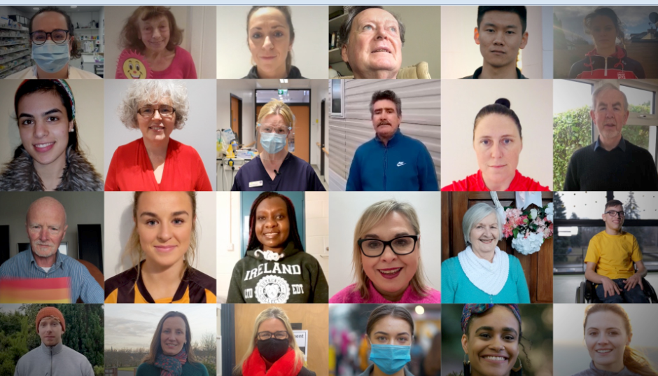


COVID-19 Vaccine Booster Dose
Partner Pack
October 2021

Slide 2
COVID-19 Vaccine Booster Dose
If you have received a COVID-19 vaccine course, you should get
a booster dose if you are:
• 80 or older, or
• 65 or older and living in a nursing home or long-term care
facility.
Why some people need a booster vaccine
All COVID-19 vaccines licenced in Ireland are effective at
protecting you against hospitalisation and severe illness from
COVID-19.
However, infections in people who are fully vaccinated can
happen, especially in older people. If you live in a nursing home or long-term care facility, you are also more at risk of severe COVID-19 because it can spread very quickly in these settings.
How you will get a booster
If you are living in long-term residential care and you are aged 65 or over, you will be vaccinated where you live.
If you are aged 80 or over and not living in residential care, you'll be invited for your vaccine by your GP. Some GPs will refer patients to a vaccination centre.
Which vaccine you will be offered
Regardless of which COVID-19 vaccine course you had previously, you will be offered a single booster dose of either the:
Pfizer/BioNTech COVID-19 vaccine
Moderna COVID-19 vaccine
More information: COVID-19 Vaccine Booster Dose

Slide 3
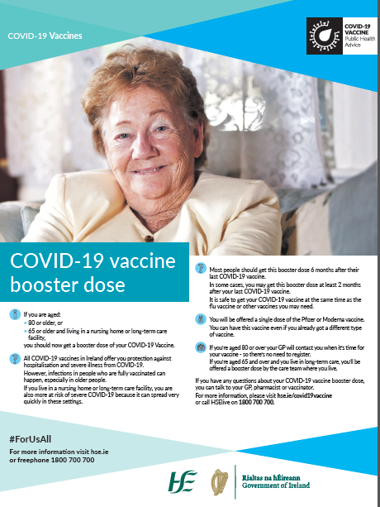
Media
Full page print ads ran in all national papers this week detailing booster vaccine dose information including eligibility and where to get the vaccine.
A radio ad highlighting the roll out of the vaccine booster dose programme is currently on national radio from October 12th -18th. You can listen to the radio ad here.

Slide 4
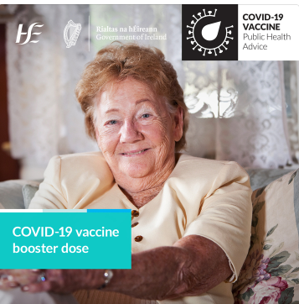
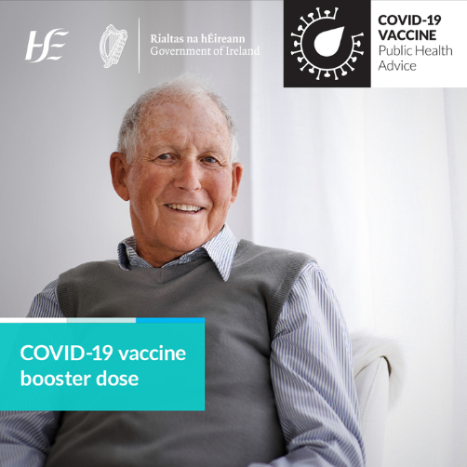
Social media
Sample message:
COVID-19 vaccines are strongly recommended to protect you from serious illness from COVID-19. If you have received a COVID-19 vaccine course, you should get a booster dose if you are:
80 or older, or
65 or older and living in a nursing home or long-term care facility
Learn more: #COVIDVaccines #ForUsAll
More information: COVID-19 vaccine booster dose

Slide 5
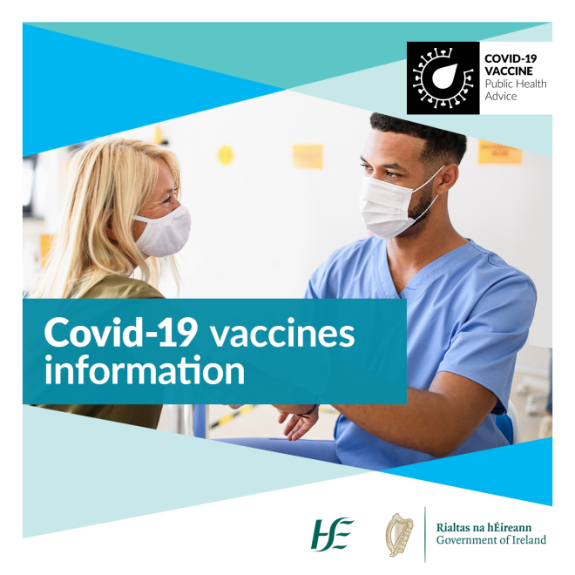
COVID-19 Vaccine Information
Clear information helps us all to make an informed decision about the vaccine.
You can find factual, updated information about COVID-19 Vaccine on www.hse.ie/covid19vaccine.
You can phone our team in HSELive on
1800 700 700.
You can email HSElive at hselive@hse.ie
Remote sign language interpretation can be arranged by appointment.
Go to our official social media channels for up to date news, videos, links and walk-in clinic details.
Downloadable information materials on the vaccines are available on www.hse.ie/covid19vaccinematerials
Vaccine information is available on this website in:
Over 24 languages, in both video and in information booklets.
Easy-Read format
Irish Sign Language
Audio, large print and braille

